Slide 1

Presentation on Databricks

Slide 2
Outline
What is Databricks?
Why Databricks?
Databrick for data warehouse & data Lakehouse.
Databricks Core components.
Demonstration on Databricks.

Slide 3
1. Introduction to Databricks
What is Databricks?
Databricks is a data and AI company that provides a unified platform for data engineering, machine learning, and analytics.
Databricks is a global data, analytics, and AI company. Databricks provides a cloud-based platform to help enterprises build, scale, and govern data and AI, including generative AI and other machine learning models.
Source:- https://www.databricks.com/company/newsroom/press-releases/databricks-announces-over-70-annualized-growth-emea-fueled

Slide 4
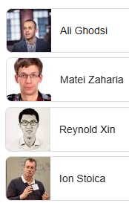
General Overview about Databricks
It emerged from the Apache Spark
It’s founding in 2013 by researchers from UC Berkeley.
Currently DB server more than 10,000 organizations worldwide.
On 2024, Databricks reached over $1.6 billion in revenue
Source:- https://www.databricks.com/company/newsroom/press-releases/databricks-announces-over-70-annualized-growth-emea-fueled
https://www.forbes.com/sites/kenrickcai/2021/05/26/accidental-billionaires-databricks-ceo-ali-ghodsi-seven-berkeley-academics/
Notes:
University of California Berkeley

Slide 5
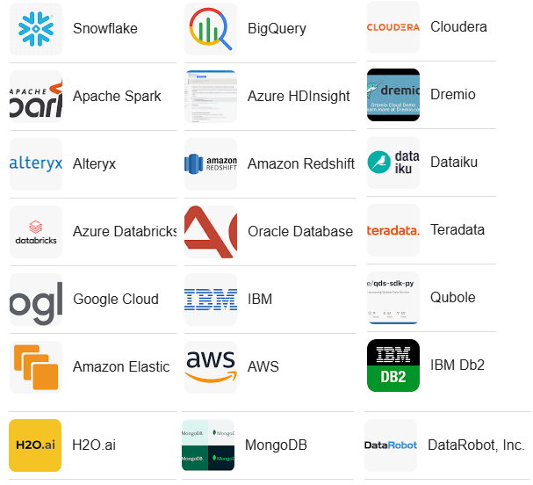
Who’s on front line?

Slide 6
2. Why Databricks?
it provides a
Unified,
Scalable platform for handling large volumes of data,
Integration of machine learning capabilities on your data within a single environment.
making it ideal for complex data processing tasks and advanced analytics, particularly when dealing with big data and AI applications, while also offering a collaborative workspace for teams to work efficiently together.
Notes:
Databricks is often considered superior to other data analytics platforms because it provides a unified, scalable platform for handling large volumes of data, integrating data engineering, data science, and machine learning capabilities within a single environment.
making it ideal for complex data processing tasks and advanced analytics, particularly when dealing with big data and AI applications, while also offering a collaborative workspace for teams to work efficiently together.
Unifying data processing involves combining data from multiple sources into a single, virtualized view. This can include data from cloud-based and on-premise sources. The goal is to create a unified view that can be used for accurate and comprehensive analysis across an organization.

Slide 7
Parameter for tool selection?
Speed: Whether the platform can execute complex queries quickly and minimize latency
Scalability: Whether the platform can efficiently process large volumes of data
Data integration: Whether the platform can connect to various data sources
Language support: Whether the platform offers support for Different language.
Cost: Whether the platform has a cost of communication, execution etc….
Source:- https://www.dataversity.net/data-lake-strategy-its-benefits-challenges-and-implementation
Notes:
As a Data Engineer we are looking the following points

Slide 8
What did Databricks offers?
They offer Lakehouse & Delta lake (two of the Databricks good at)
Data warehouse
Data warehousing refers to collecting and storing data from multiple sources so it can be quickly accessed for business insights and reporting.
Stored data in rows and columns.
Data warehouse, stores data in the form of files or folders,
Notes:
To fully understand what lakehouse is first we need to understand data warehouse and data lake
Data lake:--→ They were great for the social media and YouTube age.

Slide 9
Data lake
A central location that holds a large amount of data in its raw format.
A data lake uses a flat architecture and object storage to store the data.
Store nearly any type of data you could collect.

Slide 10
Data Lakehouse (Data lake + warehouse )
A data lakehouse is a new, open data management architecture that combines the flexibility, cost-efficiency, and scale of data lakes with the data management and ACID transactions of data warehouses, enabling business intelligence (BI) and machine learning (ML) on all data
Databricks pioneered the data Lakehouse, first announcing it in 2017.
Store nearly any type of data.
Notes:
ACID transactions are a set of properties that guarantee the reliability and consistency of database transactions. ACID stands for
Atomicity, each statement in a transaction (to read, write, update or delete data) is treated as a single unit. Either the entire statement is executed, or none of it is executed.
Consistency:- ensures that transactions only make changes to tables in predefined, predictable ways.
Isolation :-when multiple users are reading and writing from the same table all at once, isolation of their transactions ensures that the concurrent transactions don't interfere with or affect one another.
Durability. ensures that changes to your data made by successfully executed transactions will be saved, even in the event of system failure.
These properties ensure that database transactions are processed reliably even in the event of system failures.

Slide 11
Delta Lake
Delta Lake is an optimized storage layer that provides the foundation for tables in a Lakehouse on Databricks.
Delta Lake is the default format for all operations on Databricks, and it supports features such as ACID transactions, data versioning, and rollback capabilities.
It allows for handling both batch and streaming data in a unified way, making it easy to work with large-scale structured data.
Notes:
- an open-source file format that stores data in a columnar format
-column-oriented data file format designed for efficient data storage and retrieval.

Slide 12
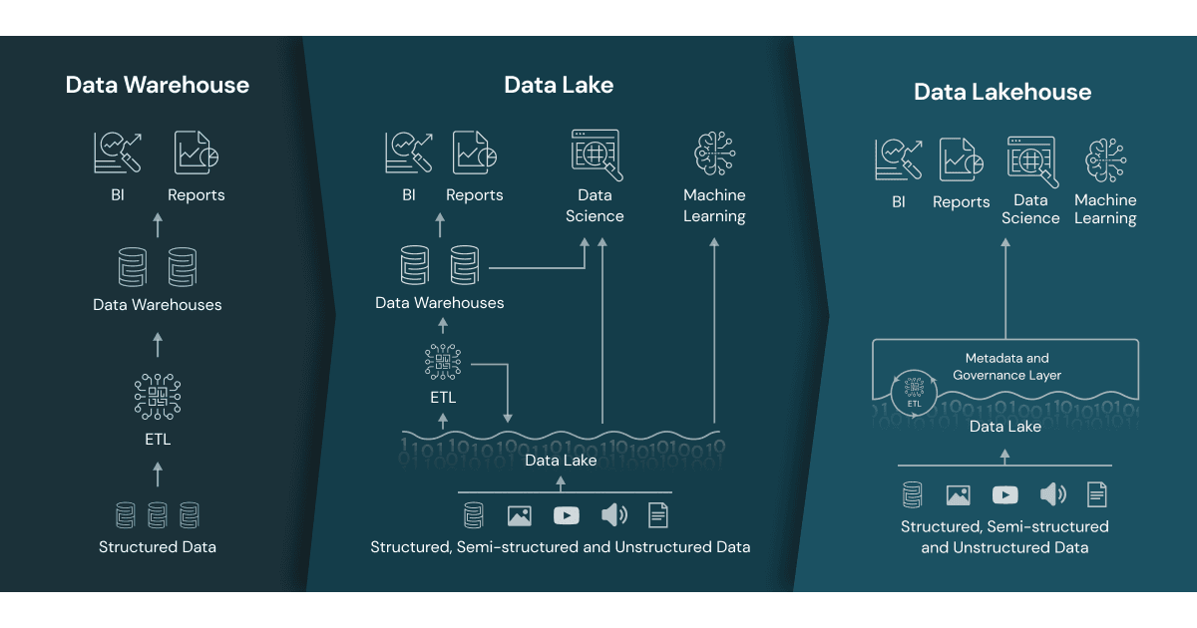
Architectural transition
Notes:
Lets finalize the architecture

Slide 13

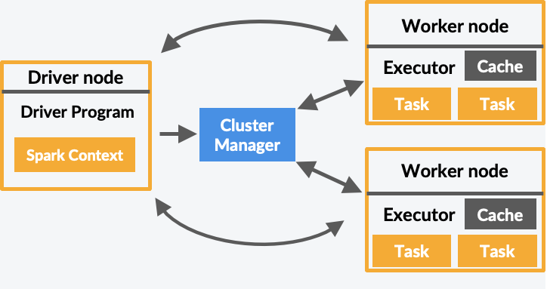
Behind the scene ….
Apache Spark
Apache Spark is an open source analytics engine used for big data workloads. handle both batches as well as real-time analytics and data processing workloads.
Notes:
Apache Spark started in 2009 as a research project at the University of California, Berkeley. Researchers were looking for a way to speed up processing jobs in Hadoop systems.

Slide 14

mlflow
MLflow is a multipurpose, expandable, open-source platform for managing workflows across the machine learning lifecycle. It has built-in integrations with many popular ML libraries, it can be used with any library, algorithm, or deployment tool.
Source:- https://mlflow.org/docs/2.2.2/concepts.html
https://www.restack.io/docs/mlflow-knowledge-mlflow-architecture-overview

Slide 15
3. Data brick for data warehouse and data Lakehouse
Data brick for data warehouse
A data warehouse is a centralized repository for structured data, optimized for querying and reporting. This is achieved through the following steps:
Data Ingestion: Load structured data from various sources into Databricks.
Data Transformation: Use Spark engine to clean, transform the data.
Data Modeling: Implement data modeling (star schema) for efficient querying.
Data Storage: Store the transformed data in a structured format in the data lake.
Data Querying: Use SQL to run complex queries and generate reports.
Source:- https://docs.databricks.com/en/sql/index.html
Notes:
Datamodel like relational database

Slide 16
Data brick for data Lakehouse
It used to store both structured and unstructured data, supports transactions, and enforces data quality. Here's how Databricks can be used to create a data Lakehouse:
Unified Data Storage: Store all types of data (structured, semi-structured, and unstructured) in a single repository.
Data Management: Use Databricks' Delta Lake to ensure data reliability, consistency, and quality.
Data Processing: Use Spark engine for batch and real-time data processing.
Data Modeling: Apply different data modeling (star schema) for efficient querying
Data Access: SQL for querying and Databricks' machine learning for advanced analytics.
Notes:
Using delta lake make it special

Slide 17
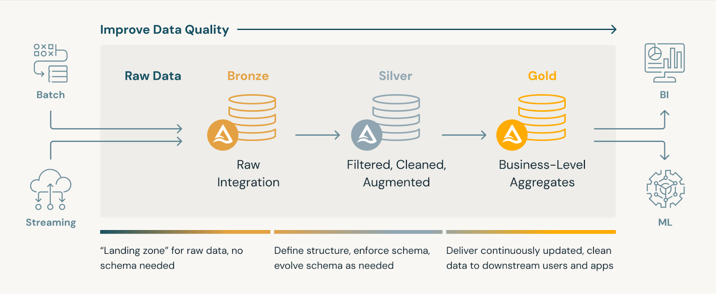
data Lakehouse medallion architecture
Source:- https://www.databricks.com/glossary/medallion-architecture
Notes:
A medallion architecture is a data design pattern used to logically organize data in a lakehouse,

Slide 18
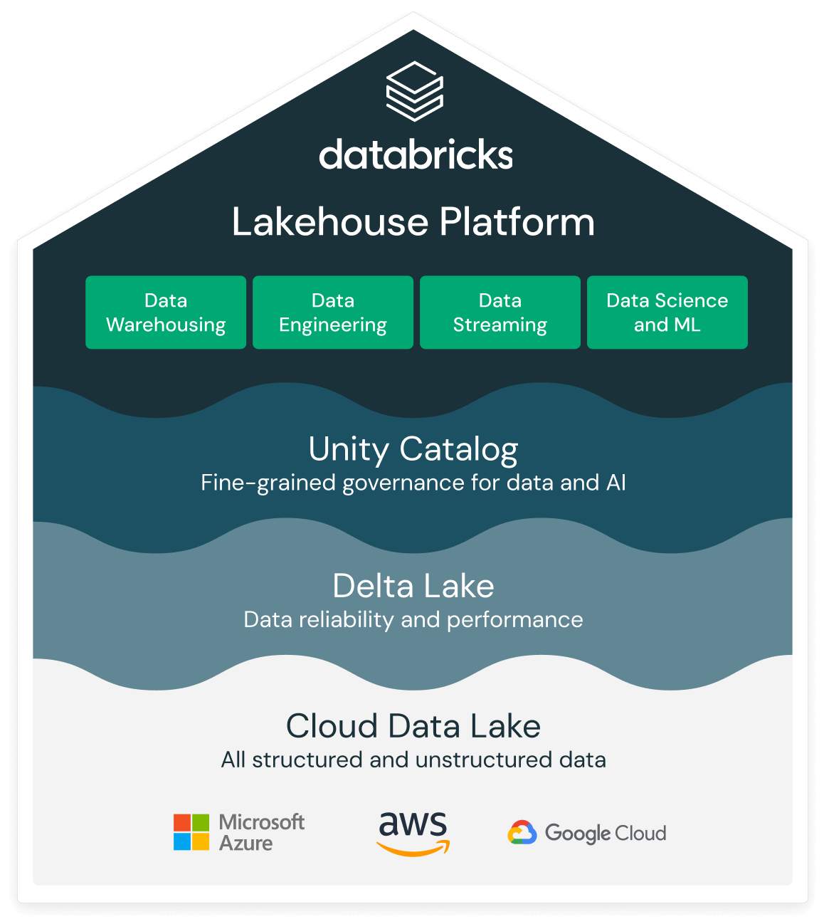
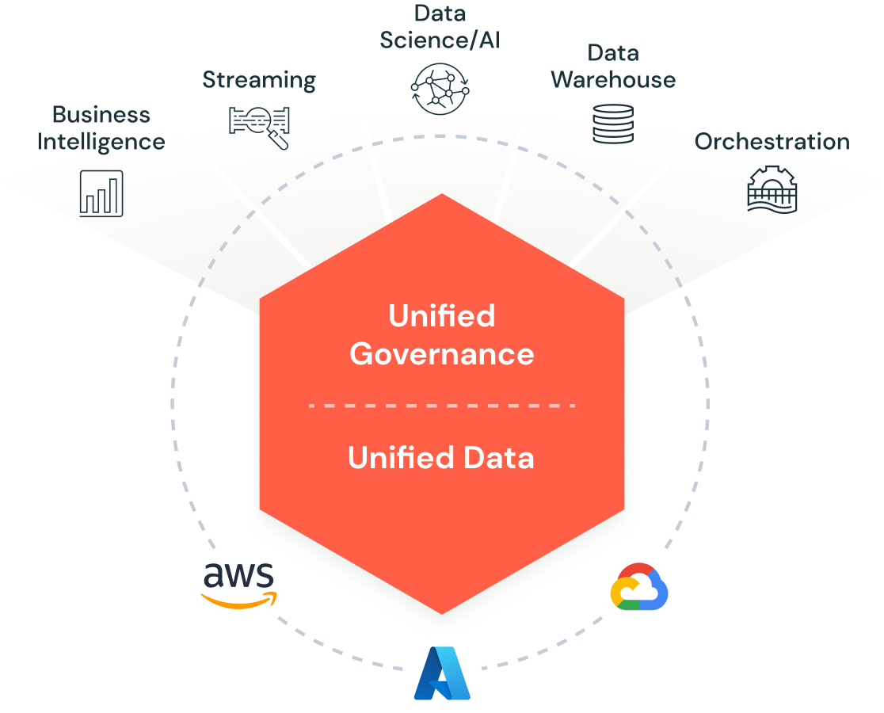
Let’s see the Architecture
Notes:
Now lets see the architecture of databricks
The Databricks Data Intelligence Platform is built on lakehouse architecture, which combines the best elements of data lakes and data warehouses to help you reduce costs and deliver on your data and AI initiatives faster.

Slide 19
4. Databricks Core components
Interface
UI:- a graphical interface for interacting with features, and data bricks objects
REST API :- provides endpoints for modifying or requesting information about Databricks account and workspace objects.
SQL REST API :-The SQL REST API allows you to automate tasks on SQL objects.
CLI:- is hosted on GitHub. The CLI is built on top of the Databricks REST API.
Source:- https://docs.databricks.com/en/getting-started/concepts.html
Notes:
Lets see some components
start with interface

Slide 20
Core components Cont..
Data management
Unity Catalog:- is a unified governance solution for data and AI assets on Databricks that provides centralized access control, auditing, lineage, and data discovery capabilities across Databricks workspaces.
DBFS root:- is a storage location available to all users by default.
Catalog Explorer:- allows you to explore and manage data and AI assets, including schemas (databases), tables, models, volumes (non-tabular data), functions, and registered ML models.
Database:-is a collection of data objects, such as tables or views and functions,
Table:-A representation of structured data. You query tables with Apache Spark and Spark APIs.
Delta table:- By default, all tables created in Databricks are Delta tables. Delta tables are based on the Delta Lake open source project

Slide 21
Core components Cont..
computational management
Cluster:- A set of computation resources and configurations on which you run notebooks and jobs.
Jobs:- A non-interactive mechanism for orchestrating and scheduling notebooks, libraries, and other tasks.
Pipelines:-Delta Live Tables Pipelines provide a declarative framework for building reliable, maintainable, and testable data processing pipelines
Workload:- Workload is the amount of processing capability needed to perform a task or group of tasks. Databricks identifies two types of workloads: data engineering (job) and data analytics (all-purpose).
Execution context:-The state for a read–eval–print loop (REPL) environment for each supported programming language. The languages supported are Python, R, Scala, and SQL.

Slide 22
Core components Cont..
Data engineering
Workspace:- is an environment for accessing all of your Databricks assets and Objects like (notebooks, libraries, dashboards, and experiments)
Notebook:- is a web-based interface for creating data science and machine learning workflows that can contain runnable commands, visualizations, and narrative text.
Library:- is a package of code available to the notebook or job running on your cluster. Databricks have many libraries, and you can also upload your own.
Git folder:- is a folder whose contents are co-versioned together by syncing them to a remote Git repository. It integrate with Git to provide source and version control for your projects.

Slide 23
To Sum up….
What Databrick is
Why Databricks
Architecture
Role of Data Engineer

Slide 24
Databricks in Action
Demo content
Put your data on google sheet
Create a pipline on Databricks
Create a table
Create a function
Create AI agent
Create Dashboard

